Slide 1
CanSat 2022 Preliminary Design Review (PDR) Outline Version 1.1
1064
UCASAL

Slide 2
Presentation Outline
Contents | Presenter
Team Organization | Jorge Royon
Acronyms | Jorge Royon
Systems Overviews | Jorge Royon
Sensor Subsystem Design | Nicole Castro
Descent Control Design | Jorge Royon
Mechanical Subsystem Design | Jorge Royon
Communication and Data Handling (CDH) Subsystem Design | Nicole Castro Agustina Romero
Electrical Power Subsystem (EPS) Design | Nicole Agustina Castro Agustina Romero
Flight Software (FSW) Design | Ivan Maccio
Ground Control System (GCS) Design | Ivan Maccio
Cansat Integration and Test | Ivan Maccio
Presenter: Name goes here

Slide 3
Team Organization
Presenter: Name goes here

Slide 4
Acronyms
Acronyms | Analysis
CDR | Critical design review
Hz | Frequency
DCS | Descent Control System
FRR | Flight Readiness Review
GCS | Ground Control Station
CG | Center of gravity
LCO | Launch Control Officer
RPM | Revolution per minute
Presenter: Name goes here

Slide 5
Systems Overview
Jorge Royon

Slide 6
Mission Summary
MAIN OBJECTIVES
Design a Cansat that shall consist of a container and a payload. The Cansat shall be launched to an altitude ranging from 670 meters to 725 meters above the launch site and deployed near apogee (peak altitude).
The Cansat must survive the forces incurred at launch and deployment.
The Cansat shall descend using a parachute at a rate of 15 m/s.
At 400 meters, the Cansat shall deploy a larger parachute to reduce the descent rate to 5 m/s.
At 300 meters, the Cansat shall release a tethered payload to a distance of 10 meters in 20 seconds.
During that time, the payload shall maintain the orientation of a video camera pointing in the south direction.
The video camera shall be pointed 45 degrees downward to assure terrain is in the video.
Presenter: Name goes here

Slide 7
System Requirement Summary
REQ | DESCRIPTION
1 | Total mass of the CanSat (science payloads and container) shall be 600 grams +/- 10 grams.
2 | CanSat shall fit in a cylindrical envelope of 125 mm diameter x 400 mm length. Tolerances are to be included to facilitate container deployment from the rocket fairing.
3 | The container shall not have any sharp edges to cause it to get stuck in the rocket payload section which is made of cardboard.
4 | The container shall be a fluorescent color; pink, red or orange.
5 | The container shall be solid and fully enclose the science payloads. Small holes to allow access to turn on the science payloads are allowed. The end of the container where the payload deploys may be open.
6 | The rocket airframe shall not be used to restrain any deployable parts of the CanSat.
7 | The rocket airframe shall not be used as part of the CanSat operations.
8 | The container’s first parachute shall not be enclosed in the container structure. It shall be external and attached to the container so that it opens immediately when deployed from the rocket.
9 | The Parachutes shall be fluorescent Pink or Orange
Presenter: Name goes here

Slide 8
System Requirement Summary
REQ | DESCRIPTION
10 | The descent rate of the CanSat (container and science payload) shall be 15 meters/second +/- 5m/s after deployment while above 400 meters.
11 | The descent rate of the CanSat shall be reduced to 5 meters/second +/-2 m/s when the CanSat descends below 400 meters.
12 | 0 altitude reference shall be at the launch pad.
13 | All structures shall be built to survive 15 Gs of launch acceleration.
14 | All structures shall be built to survive 30 Gs of shock.
15 | All electronics shall be hard mounted using proper mounts such as standoffs, screws, or high performance adhesives.
16 | All mechanisms shall be capable of maintaining their configuration or states under all forces.
17 | Mechanisms shall not use pyrotechnics or chemicals.
18 | Mechanisms that use heat (e.g., nichrome wire) shall not be exposed to the outside environment to reduce potential risk of setting vegetation on fire.
Presenter: Name goes here

Slide 9
System Requirement Summary
REQ | DESCRIPTION
19 | Both the container and payload shall be labeled with team contact information including email address.
20 | Cost of the CanSat shall be under $1000. Ground support and analysis tools are not included in the cost. Equipment from previous years should be included in this cost, based on current market value.
21 | XBEE radios shall be used for telemetry. 2.4 GHz Series radios are allowed. 900 MHz XBEE radios are also allowed.
22 | XBEE radios shall have their NETID/PANID set to their team number.
23 | XBEE radios shall not use broadcast mode.
24 | The container shall include electronics to receive sensor payload telemetry.
25 | The container shall include electronics and mechanisms to release the science payload on a tether.
26 | The container shall include a GPS sensor to track its position.
27 | The container shall include a pressure sensor to measure altitude.
28 | The container shall measure its battery voltage.
Presenter: Name goes here

Slide 10
System Requirement Summary
REQ | DESCRIPTION
29 | The container shall transmit its telemetry once per second (1 Hz) in the formats described in the Telemetry Requirements section.
30 | The container shall poll the payload for telemetry and relay that data four times per second (4 Hz) in the formats described in the Telemetry Requirements section.
31 | The container shall stop polling and transmitting telemetry when it lands.
32 | The container and science payload must include an easily accessible power switch that can be accessed without disassembling the cansat and science payloads and in the stowed configuration.
33 | The container and payload must include a power indicator such as an LED or sound generating device that can be easily seen or heard without disassembling the cansat and in the stowed state.
34 | An audio beacon is required for the container. It shall be powered after landing.
35 | The audio beacon must have a minimum sound pressure level of 92 dB, unobstructed.
36 | Battery source may be alkaline, Ni-Cad, Ni-MH or Lithium. Lithium polymer batteries are not allowed. Lithium cells must be manufactured with a metal package similar to 18650 cells. Coin cells are allowed.
Presenter: Name goes here

Slide 11
System Requirement Summary
REQ | DESCRIPTION
37 | An easily accessible battery compartment must be included allowing batteries to be installed or removed in less than a minute and not require a total disassembly of the CanSat.
38 | Spring contacts shall not be used for making electrical connections to batteries. Shock forces can cause momentary disconnects.
39 | The Cansat must operate during the environmental tests laid out in Section 3.5.
40 | The Cansat shall operate for a minimum of two hours when integrated into the rocket.
41 | The science payload shall have their NETID/PANID set to their team number plus 5000. If the team number is 1000, sensor payload NETID is 6000.
42 | The science payload shall transmit sensor telemetry to the container when polled.
43 | The science payload shall include a pressure sensor, temperature sensor and rotation sensor.
44 | The science payload shall include a video camera pointing 45 degrees up from the payload NADIR direction.
45 | The science payload shall maintain orientation so the camera always faces south within +/- 20 degrees.
Presenter: Name goes here

Slide 12
System Requirement Summary
REQ | DESCRIPTION
46 | The payload shall be connected to the container with a 10 meter tether.
47 | At 300 meters, the payload shall be released from the container at a rate of .5 meters per second.
48 | The flight software shall maintain a count of packets transmitted which shall increment with each packet transmission throughout the mission. The value shall be maintained through processor resets.
49 | The container shall maintain mission time throughout the whole mission even with processor resets or momentary power loss.
50 | The container shall have its time set to UTC time to within one second before launch.
51 | The container flight software shall support simulated flight mode where the ground station sends air pressure values at a one second interval using a provided flight profile csv file.
52 | In simulation mode, the flight software shall use the radio uplink pressure values in place of the pressure sensor for determining the container altitude.
53 | The container flight software shall only enter simulation mode after it receives the SIMULATION ENABLE and SIMULATION ACTIVATE commands.
Presenter: Name goes here

Slide 13
System Requirement Summary
REQ | DESCRIPTION
54 | The ground station shall command the Cansat to start transmitting telemetry prior to launch.
55 | The ground station shall generate csv files of all sensor data as specified in the Telemetry Requirements section.
56 | Telemetry shall include mission time with one second or better resolution. Mission time shall be maintained in the event of a processor reset during the launch and mission.
57 | Configuration states such as if commanded to transmit telemetry shall be maintained in the event of a processor reset during launch and mission.
58 | Each team shall develop their own ground station.
59 | All telemetry shall be displayed in real time during descent on the ground station.
60 | All telemetry shall be displayed in engineering units (meters, meters/sec, Celsius, etc.)
61 | Teams shall plot each telemetry data field in real time during flight.
62 | The ground station shall include one laptop computer with a minimum of two hours of battery operation, XBEE radio and a hand-held antenna.
Presenter: Name goes here

Slide 14
System Requirement Summary
REQ | DESCRIPTION
63 | The ground station must be portable so the team can be positioned at the ground station operation site along the flight line. AC power will not be available at the ground station operation site.
64 | The ground station software shall be able to command the container to operate in simulation mode by sending two commands, SIMULATION ENABLE and SIMULATION ACTIVATE.
65 | When in simulation mode, the ground station shall transmit pressure data from a csv file provided by the competition at a 1 Hz interval to the container.
66 | The science payloads shall not transmit telemetry during the launch, and the container shall command the science payloads to begin telemetry transmission upon release from the container.
67 | All video cameras shall be in color, have a resolution of at least 640x480 and record at a minimum of 30 frames a second.
Presenter: Name goes here

Slide 15
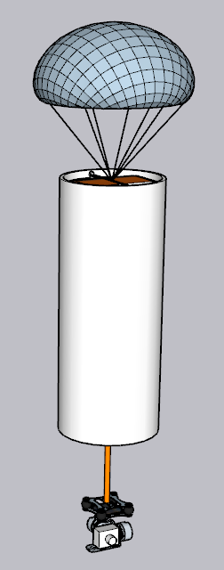
System Level CanSat Configuration Trade & Selection
CONFIGURATION 1
General description:
Payload consist on a 3 axis gimbal for smooth and precise stabilization
Second parachute is retained by a rubber band and a servo, the first parachute is tethered with cotton strings to the second one
Electronics in container and payload for easy manipulation and to use all the space available
3D printed container for thin walls to maximize useful space and lightweight
PROS:
Container is 3d printed and saves precious building time
Gimbal are a proven method to stabilize cameras even in rough conditions
Easy to build
CONS:
Container is fragile
Expensive
Presenter: Name goes here

Slide 16
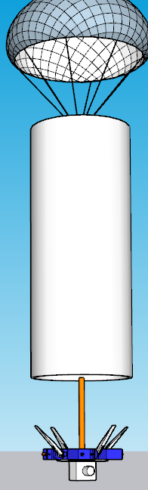
System Level CanSat Configuration Trade & Selection
CONFIGURATION 2
General description:
Payload consist on a platform that had 4 servos with movable fins to stabilize camera
Second parachute is retained by a rubber band and a servo, the first parachute is tethered with cotton strings to the second one
Electronics in container and payload for easy manipulation and to use all the space available
3D printed container for thin walls to maximize useful space and lightweight
PROS:
Container is 3d printed and saves precious building time
Easy to build
CONS:
Container is fragile
Too many servos
Can be hard to program
Stabilization depends on wind speed that are impredictable
Presenter: Name goes here

Slide 17
System Level Configuration Selection
CONFIGURATION 1 SELECTED
Rationale:
We choose configuration 1 because uses proven and reliable methods and is easy to build
Presenter: Name goes here

Slide 18
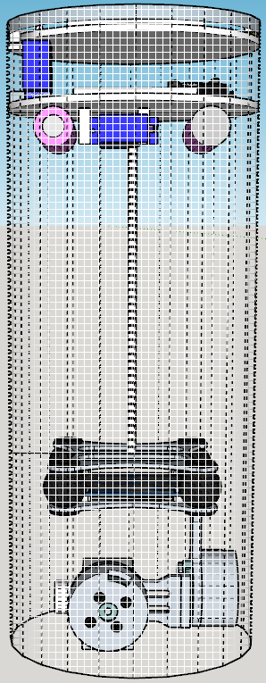
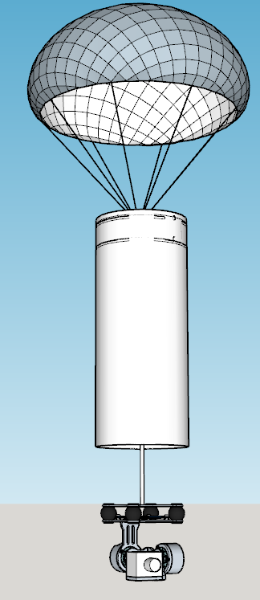
Physical Layout
STOWED STATE
DEPLOYED STATE
Presenter: Name goes here

Slide 19
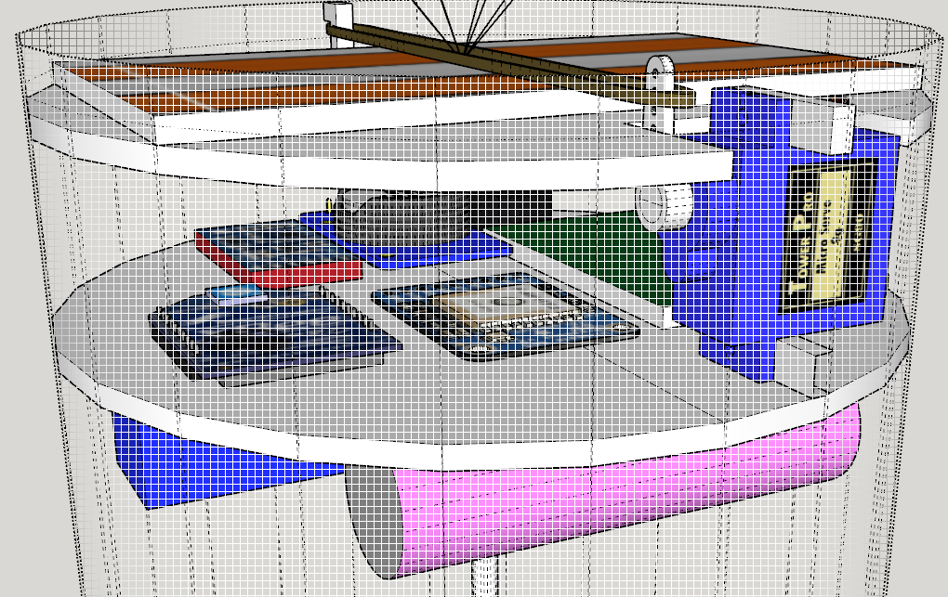
Physical Layout
CONTAINER
The container consist on two bays, one to hold the parachutes and the other one to hold the electronics, both are hold to the container with wood screw
Presenter: Name goes here

Slide 20
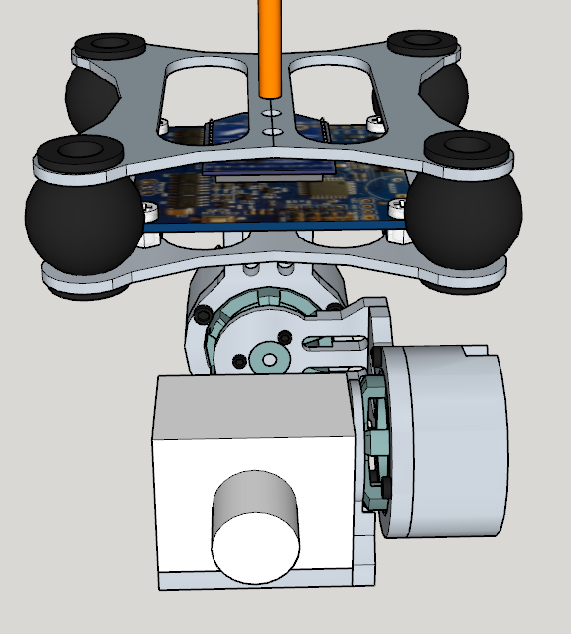
Physical Layout
PAYLOAD
The payload consist in a 3 axis stabilization gimbal that keeps the camera at the required angle and has a bay for all the electronics
Presenter: Name goes here

Slide 21
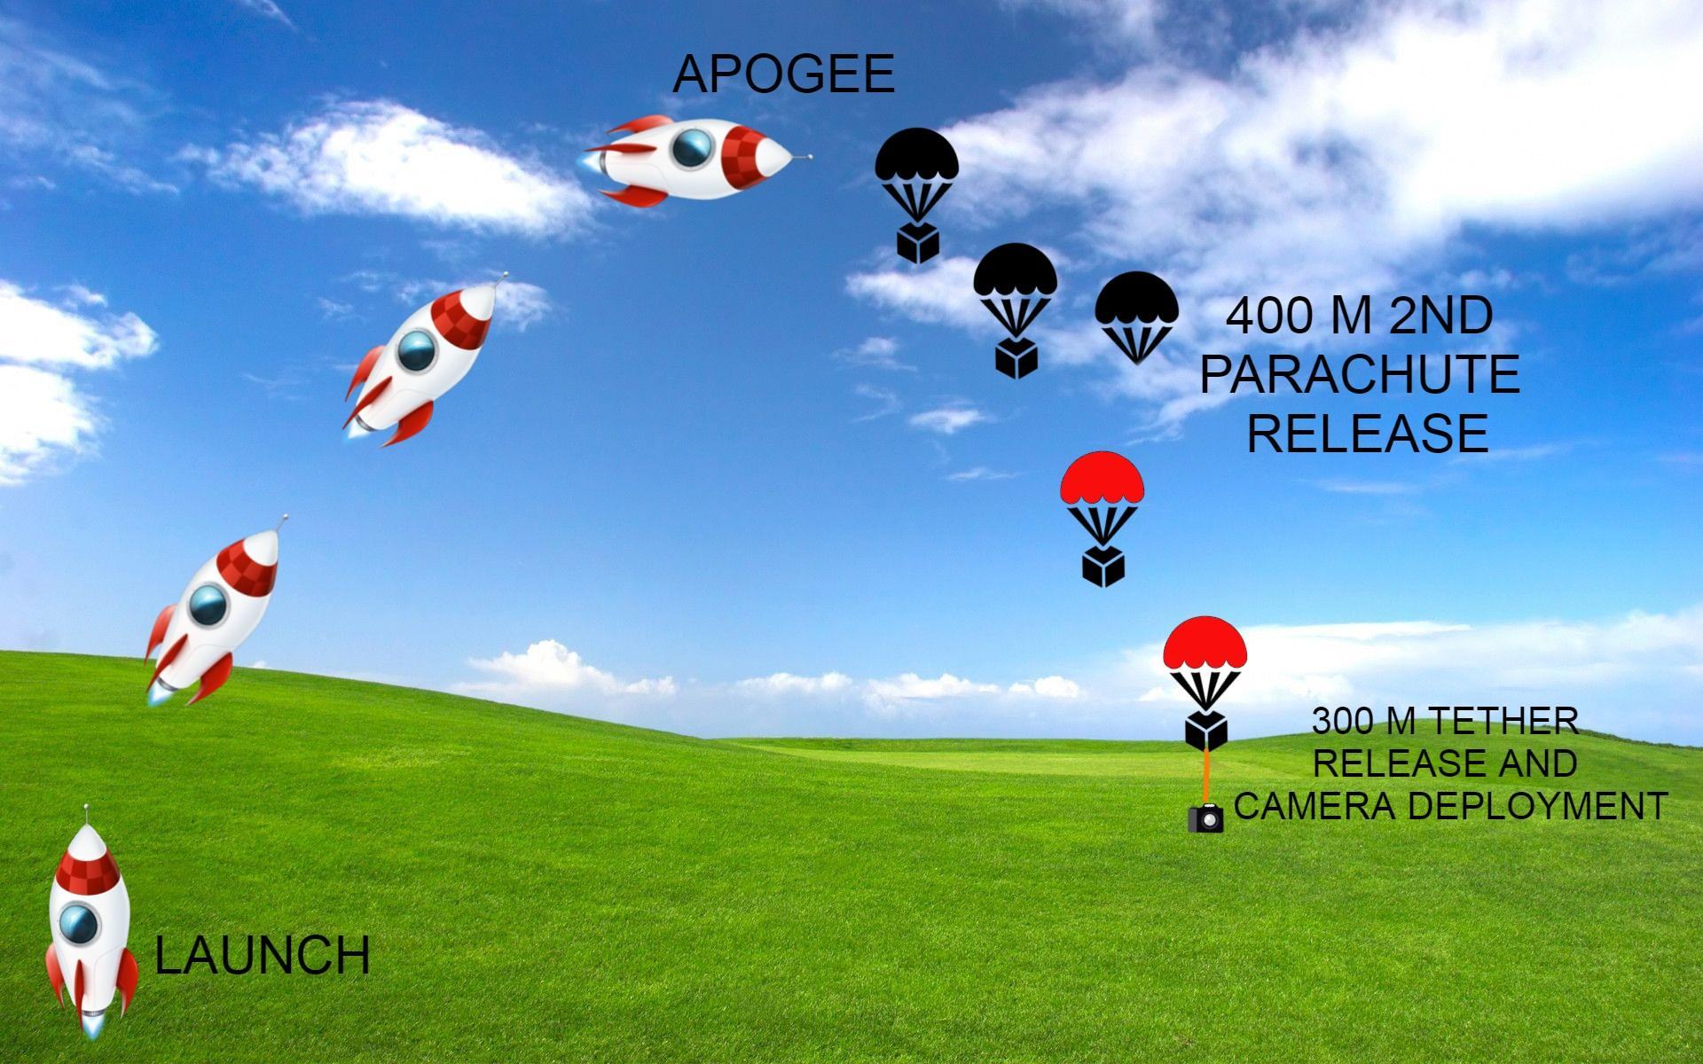
System Concept of Operations
Presenter: Name goes here

Slide 22
System Concept of Operations
1
2
3
●Competition area arrival
●Team briefing
●Checklist of materials
●Deploy Ground Control Station
●Last check of fully integrated CanSat
●Placement of CanSat into the
rocket payload section
●Launch CanSat.
●Container deploy.
●Payload deploy.
●Record telemetry.
●Recovery of Payload and Container
●Analysis of sampled data
●Preparation of the PFR
●PFR presentation and delivery
Presenter: Name goes here

Slide 23
Launch Vehicle Compatibility
★Rocket payload section dimensions based on Mission Guide:
○Height: 310 mm
○Diameter: 125 mm
★CanSat dimensions:
○Height: 300 mm
○Diameter: 120 mm
★Payload dimensions:
○Diameter: 100mm
○Height: 90 mm
★First Parachute dimensions:
○Diameter: 190 mm
○Spill Hole Diameter: 42.56 mm
★Second Parachute dimensions:
○Diameter: 190 mm
○Spill Hole Diameter: 42.56 mm
Presenter: Name goes here

Slide 24
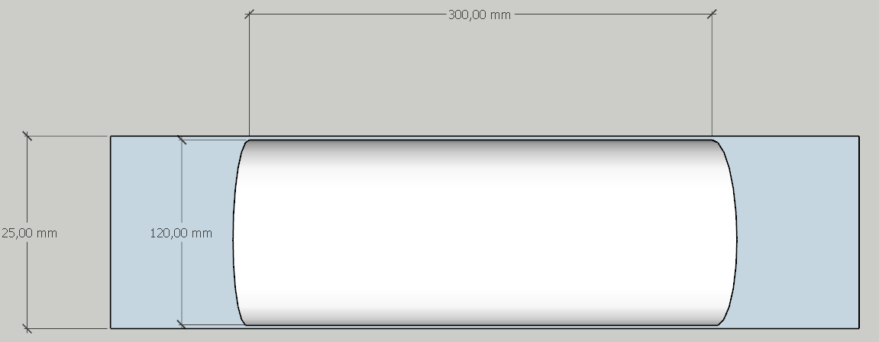
Launch Vehicle Compatibility
There's enough space for the Container freely slide in the rocket frame
Presenter: Name goes here

Slide 25
Sensor Subsystem Design
Presenter Name(s) Go Here

Slide 26
Sensor Subsystem Overview
One slide providing an overview of the CanSat sensor subsystem
Include summary of the selected sensors (type & models)
Include brief discussion of what the sensors are used for
Focus on selected component (not all components trades)
Presenter: Name goes here

Slide 27
Container Air Pressure Sensor Trade & Selection
Summary of air pressure sensor trade study and selection
Include details such as interfaces, resolution, cost, size, weight and any other factors for the trade
Show at least two different sensors (same for all other slides)
Indicate which sensor is selected and reasons for selection
See slide discussing trade studies at the end of this PowerPoint
Presenter: Name goes here

Slide 28
Container GPS Sensor Trade & Selection
Summary of GPS sensor trade study and selection
Include details such as interfaces, resolution, cost, size, weight and any other factors for the trade
Show at least two different sensors (same for all other slides)
Indicate which sensor is selected and reasons for selection
See slide discussing trade studies at the end of this PowerPoint
Presenter: Name goes here

Slide 29
Container Battery Voltage Sensor Trade & Selection
Summary of Payload battery voltage sensor trade study and selection
Include details such as interfaces, resolution, cost, size, weight and any other factors for the trade
Show at least two different sensors (same for all other slides)
Indicate which battery is selected and reasons for selection
See slide discussing trade studies at the end of this PowerPoint
Presenter: Name goes here

Slide 30
Payload Air Pressure Sensor Trade & Selection
Summary of air pressure sensor trade study and selection
Include details such as interfaces, resolution, cost, size, weight and any other factors for the trade
Show at least two different sensors (same for all other slides)
Indicate which sensor is selected and reasons for selection
See slide discussing trade studies at the end of this PowerPoint
Presenter: Name goes here

Slide 31
Payload Air Temperature Sensor Trade & Selection
Summary of air temperature sensor trade study and selection
Include details such as interfaces, resolution, cost, size, weight and any other factors for the trade
Show at least two different sensors (same for all other slides)
Indicate which sensor is selected and reasons for selection
See slide discussing trade studies at the end of this PowerPoint
Presenter: Name goes here

Slide 32
Payload Battery Voltage Sensor Trade & Selection
Summary of Payload battery voltage sensor trade study and selection
Include details such as interfaces, resolution, cost, size, weight and any other factors for the trade
Show at least two different sensors (same for all other slides)
Indicate which battery is selected and reasons for selection
See slide discussing trade studies at the end of this PowerPoint
Presenter: Name goes here

Slide 33
Payload Rotation Control Sensor Trade & Selection
Summary trade study and selection of sensors used to control the payload camera pointing trade study and selection
Include details such as interfaces, resolution, cost, size, weight and any other factors for the trade
Show at least two different sensors (same for all other slides)
Indicate which sensor is selected and reasons for selection
See slide discussing trade studies at the end of this PowerPoint
Presenter: Name goes here

Slide 34
Payload Camera Trade & Selection
Summary of camera trade study and selection
Include details such as interfaces, resolution, cost, size, weight and any other factors for the trade
Show at least two different sensors (same for all other slides)
Indicate which sensor is selected and reasons for selection
See slide discussing trade studies at the end of this PowerPoint
Presenter: Name goes here

Slide 35
Bonus Camera Trade and Selection
Summary of camera trade study and selection
Include details such as interfaces, resolution, cost, size, weight and any other factors for the trade
Show at least two different sensors (same for all other slides)
Indicate which sensor is selected and reasons for selection
Presenter: Name goes here

Slide 36
Descent Control Design
Presenter Name(s) Go Here

Slide 37
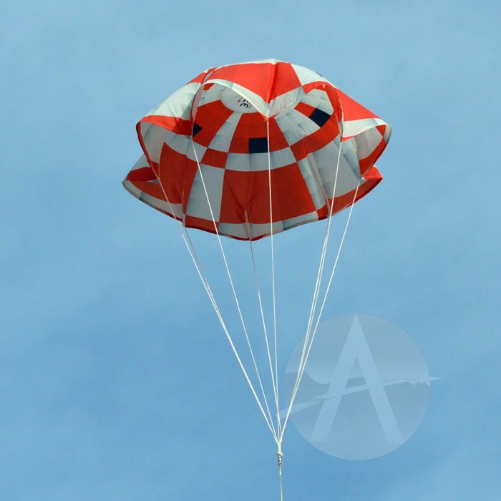
Descent Control Overview
Container Descent Control System
The parachute has 19 cm diameter to reach 15 m/s. It has been made from plastic and It has 2.28 cm radius spill hole to stabilize container during descent
Presenter: Name goes here

Slide 38

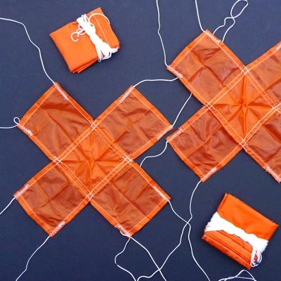
Container Descent Control Strategy Selection and Trade
DOME PARACHUTE
X TYPE PARACHUTE
Presenter: Name goes here

Slide 39
Container Descent Control Strategy Selection and Trade
DOME PARACHUTE | X TYPE PARACHUTE
Stability is easily ensured by a spill hole. | Easy to stack.
High drag coefficient. | Low drag coefficient.
Easy to make. | Easy to manufacture.
Requires less space when stacked. | Lightweight.
Horizontal displacement is low.
We selected the Parachute Dome due the following reasons:
•Apogee model 29126 is cheap
•Apogee model 29126 accomplish all requirement
•Apogee model 29126 Will be painted orange to meet requirements
Presenter: Name goes here

Slide 40
Container Descent Control Strategy Selection and Trade
DOME PARACHUTE | X TYPE PARACHUTE
Stability is easily ensured by a spill hole. | Easy to stack.
High drag coefficient. | Low drag coefficient.
Easy to make. | Easy to manufacture.
Requires less space when stacked. | Lightweight.
Horizontal displacement is low.
For the second parachute we also choose dome parachute:
•Apogee model 29118 is cheap
•Apogee model 29118 accomplish all requirement
•Apogee model 29118 Will be painted orange to meet requirements
Presenter: Name goes here

Slide 41
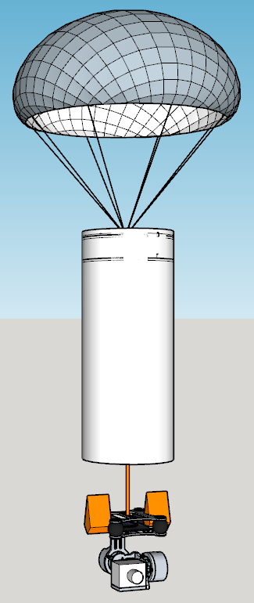
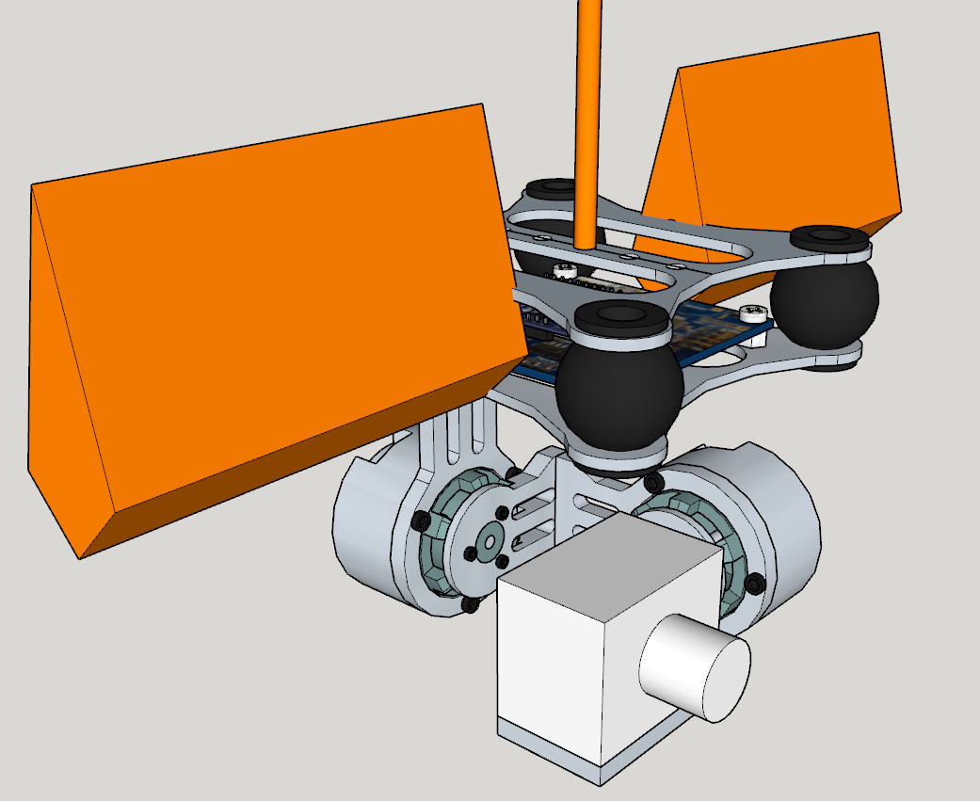
Container and Payload Descent Stability Control Strategy Selection and Trade
OPTION A
DESCRIPTION:
We consider the use of a 3d printed flexible passive aileron to improve stability
PROS:
Improve stability
Mitigate bounces inside the container when stowed
CONS:
Stability is slightly improved
More weight
Presenter: Name goes here

Slide 42
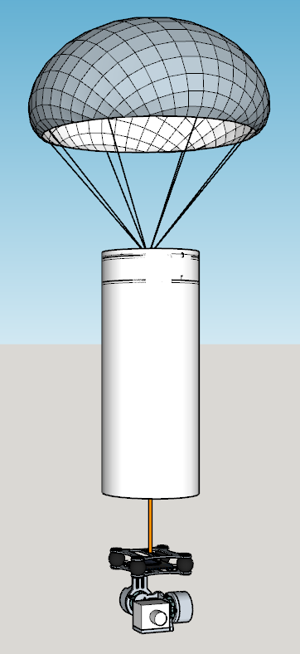
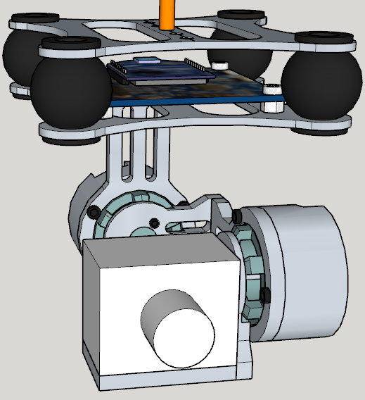
Container and Payload Descent Stability Control Strategy Selection and Trade
OPTION B
DESCRIPTION
We consider that the weight of the payload in the bottom on the container and when deployed it will be 10M away will be enough to stabilize it.
PROS:
Easy to build
Lightweight
CONS:
Stability is achieved in a passive way and high speed winds can be a problem
Presenter: Name goes here

Slide 43
Container Descent Control Strategy Selection and Trade
OPTION A | OPTION B
Stability is slightly improved. | Easy to stack.
Mitigate bounces inside the container | Easy to manufacture.
 | Lightweight.
We choose the option B because the option A is not worth the effort to build
Presenter: Name goes here

Slide 44
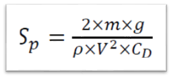
Descent Rate Estimates
Container Descent Rate Estimate
The area formula of the first parachute with spill hole is where
𝑆𝑝= Area of the parachute with a spill hole ( 𝑚2 )
𝐷= The diameter of the parachute 𝑚𝑚
𝑉= Descent speed 𝑚/𝑠
𝐶𝐷= 1.5 Drift coefficient of parachute
𝜌= 1.225 kg/𝑚3(Air density at +15 C from sea level)
𝑚=0.600kg Container+Payload
𝑔=9.81𝑚/𝑠2
S_(s_H ) =Spill hole area
S_Hr =Spill hole radius
Presenter: Name goes here

Slide 45
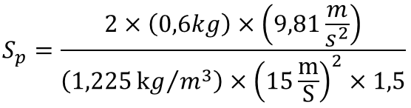
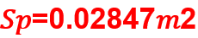
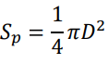
Descent Rate Estimates
Container Descent Rate Estimate
Replacing the data gives the following results
The diameter can be calculated from the formula
Presenter: Name goes here

Slide 46
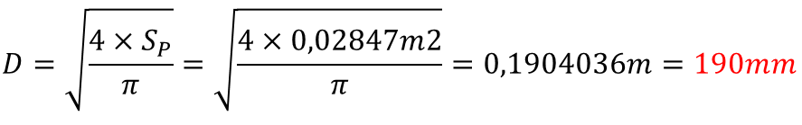
Descent Rate Estimates
Container Descent Rate Estimate
Clearing terms and replacing the data give us
The spill house area is chosen to be 5% of the total parachute area
Presenter: Name goes here

Slide 47
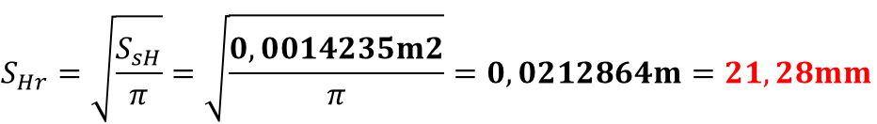
Descent Rate Estimates
Container Descent Rate Estimate
The spill house radius can be determined by
This give us a parachute of a 190 mm in diameter with a spill house radius of 21,28 mm for the first parachute
Presenter: Name goes here

Slide 48
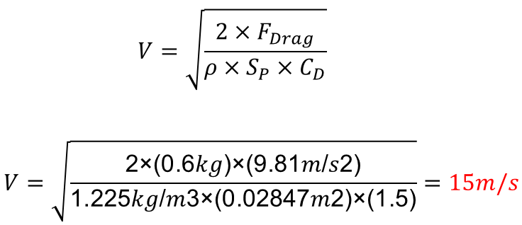
Descent Rate Estimates
Container Descent Rate Estimate
Now we can estimate the descent speed of the container with the payload
With these result we accomplish the mission requirements for the first stage
Presenter: Name goes here

Slide 49
Descent Rate Estimates
Container Descent Rate Estimate
The area formula of the second parachute with spill hole is where
𝑆𝑝= Area of the parachute with a spill hole ( 𝑚2 )
𝐷= The diameter of the parachute 𝑚𝑚
𝑉= Descent speed 𝑚/𝑠
𝐶𝐷= 1.5 Drift coefficient of parachute
𝜌= 1.225 kg/𝑚3(Air density at +15 C from sea level)
𝑚=0.600kg Container+Payload
𝑔=9.81𝑚/𝑠2
S_(s_H ) =Spill hole area
S_Hr =Spill hole radius
Presenter: Name goes here

Slide 50
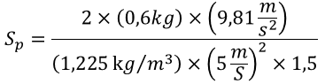

Descent Rate Estimates
Container Descent Rate Estimate
Replacing the data gives the following results
The diameter can be calculated from the formula
Presenter: Name goes here

Slide 51
Descent Rate Estimates
Container Descent Rate Estimate
Clearing terms and replacing the data give us
The spill house area is chosen to be 5% of the total parachute area
Presenter: Name goes here

Slide 52
Descent Rate Estimates
Container Descent Rate Estimate
The spill house radius can be determined by
This give us a parachute of a 190 mm in diameter with a spill house radius of 21,28 mm for the first parachute
Presenter: Name goes here

Slide 53
Descent Rate Estimates
Container Descent Rate Estimate
Now we can estimate the descent speed of the container with the payload
With these result we accomplish the mission requirements for the first stage
Presenter: Name goes here

Slide 54
Descent Rate Estimates
Presenter: Name goes here

Slide 55
Mechanical Subsystem Design
Presenter Name(s) Go Here

Slide 56
Mechanical Subsystem Overview
One slide providing overview of the mechanical subsystem
Include overview of major structural elements, material selection, and interface definitions
Include science payload and container mechanical configurations
Presenter: Name goes here

Slide 57
Container Mechanical Layout of Components Trade & Selection
Key trade issues related to mechanical layout and component selection
Show structure of Container
Identify location of electrical components
Identify major mechanical parts
mechanisms such as springs, hinges, etc.
Show at least two mechanical layouts
Indicate selection and reasons for selection
Show structural material selection(s)
See slide discussing trade studies at the end of this PowerPoint
Presenter: Name goes here

Slide 58
Payload Mechanical Layout of Components Trade & Selection
Key trade issues related to mechanical layout and component selection
Show structure of Payload
Identify location of electrical components
Identify major mechanical parts
mechanisms such as springs, hinges, etc.
Show at least two mechanical layouts
Indicate selection and reasons for selection
Show structural material selection(s)
See slide discussing trade studies at the end of this PowerPoint
Presenter: Name goes here

Slide 59
Payload Pre Deployment Configuration Trade & Selection
Key trade issues related to how the payload is stowed in the container
Show stowed configuration diagram
Explain mechanisms used to keep payload in stowed configuration
See slide discussing trade studies at the end of this PowerPoint
Presenter: Name goes here

Slide 60
Payload Deployment
Configuration Trade & Selection
Key trade issues related to how the payload transitions from stowed to deployed configuration
Explain mechanisms used to transition to deployed configuration, ie hinges, springs, etc.
See slide discussing trade studies at the end of this PowerPoint
Presenter: Name goes here

Slide 61
Tether Design Trade & Selection
Key trade issues related to how the tether is unspooled
Explain mechanisms used to control the unspooling rate
See slide discussing trade studies at the end of this PowerPoint
Presenter: Name goes here

Slide 62
Tether Material Trade & Selection
Key trade issues related to the tether material
Selection of material and reasons for selection
See slide discussing trade studies at the end of this PowerPoint
Presenter: Name goes here

Slide 63
Container First Parachute Attachment Mechanism
Describe how the parachute will be attached to the container and how it is stowed before being released
Include:
Diagrams
Method of operation
Be detailed in how it works.
Keep it simple. Parachute just sits on top of container.
Presenter: Name goes here

Slide 64
Container Second Parachute Deployment Mechanism Trade and Selection
Describe how the parachute will be attached to the container, how it is stowed before being released and how it is released
Include:
Diagrams
Method of operation
Be detailed in how it works.
Presenter: Name goes here

Slide 65
Electronics Structural Integrity
Electronic component mounting methods
Electronic component enclosures
Securing electrical connections (glue, tape, etc.)
Consider required judge verification during pre-flight check in
Descent control attachments
Presenter: Name goes here

Slide 66
Mass Budget
Table(s) providing the following:
Mass of each component of payload and container
Mass of each structural element
Sources/uncertainties – whether the masses are estimates, from data sheets, measured values, etc.
Total mass of all components and structural elements
Margin : The amount of mass (in grams) in which the mass budget meets, exceeds, or falls short of the mass requirement
Method of correction to meet mass requirement (based on the margin listed above)
Must clearly distinguish between Container and Payload masses
Presenter: Name goes here

Slide 67
Communication and Data Handling (CDH) Subsystem Design
Presenter Name(s) Go Here

Slide 68
Container Command Data Handler (CDH) Overview
One slide providing overview of the payload CDH subsystem
Should include selected components (with brief mention of what each component is for)
Focus on selected component (not all components trades)
Presenter: Name goes here

Slide 69
Container Processor & Memory Trade & Selection
Include boot time
Include processor speed
Include data interfaces (types and numbers)
Include memory storage requirements, if applicable
Show at least two choices
Indicate selected choice and reasons for selection
See slide discussing trade studies at the end of this PowerPoint
Presenter: Name goes here

Slide 70
Container Real-Time Clock
Describe design for Container real-time clock
Hardware clock with independent power source
Reset tolerance
Real time clock should have independent battery backup to maintain time through power transients
Show at least two designs
Indicate selected design and reasons for selection
See slide discussing trade studies at the end of this PowerPoint
Presenter: Name goes here

Slide 71
Container Antenna Trade & Selection
Antenna selection criteria
Antenna range and patterns
Show at least two choices
Indicate selected choice and reasons for selection
Include antenna used for Container-to-Ground link and Container-to-Payload links
See slide discussing trade studies at the end of this PowerPoint
Presenter: Name goes here

Slide 72
Container Radio Configuration
Show XBEE radio selection
Show NETID
Include transmission control
How is this managed during each mission phase?
Note:
Communications failures have occurred often over the past several years of the competition
You are encouraged to use your radios in all of your development and testing to better ensure mission success
Ideally you have started working with the radio and communications protocol
Include radio configuration for Container-to-Ground link and Payload-to-Container links
Start Radio Prototyping and Testing Early!
Presenter: Name goes here

Slide 73
Container Telemetry Format
What data is included?
Check the competition guide for telemetry requirements
How is data formatted?
Include example frames with sample data and complete descriptions
Include Container frames and Payload relay frames
Does the presented format match the Competition Guide requirements?
Presenter: Name goes here

Slide 74
Container Command Formats
List all supported commands with examples
What data is included?
Check the competition guide for command requirements
How is command data formatted?
Include example commands with complete descriptions
Does the presented format match the Competition Guide requirements?
Presenter: Name goes here

Slide 75
Payload CDH Overview
One slide providing overview of the container CDH subsystem
Should include selected components (with brief mention of what each component is for)
Presenter: Name goes here

Slide 76
Payload Processor & Memory Trade & Selection
Include boot time
Include processor speed
Include data interfaces (types and numbers)
Include memory storage requirements, if applicable
Show at least two choices
Indicate selected choice and reasons for selection
If no processor, state it.
See slide discussing trade studies at the end of this PowerPoint
Presenter: Name goes here

Slide 77
Payload Antenna Trade & Selection
Antenna selection criteria
Antenna range and patterns
Show at least two choices
Indicate selected choice and reasons for selection
See slide discussing trade studies at the end of this PowerPoint
Presenter: Name goes here

Slide 78
Payload Radio Configuration
Show XBEE radio selection
Show NETID
Include transmission control
How is this managed during each mission phase?
Note:
Communications failures have occurred often over the past several years of the competition
You are encouraged to use your radios in all of your development and testing to better ensure mission success
Ideally you have started working with the radio and communications protocol
Start Radio Prototyping and Testing Early!
Presenter: Name goes here

Slide 79
Payload Telemetry Format
What data is included?
Check the competition guide for telemetry requirements
Data rate of packets?
How is data formatted?
Include example frames with sample data and complete descriptions
Does the presented format match the Competition Guide requirements?
Presenter: Name goes here

Slide 80
Electrical Power Subsystem (EPS) Design
Enzo Juarez

Slide 81
EPS Overview (1 of 4)
Component | Purpose
Battery Samsung 30Q 18650 | Power Source
XBee RX | Radio Communicator Container
XBee RX | Radio Communicator Ground Station
Adafruit Ultimate GPS | GPS Sensor
Micro Servo SG90 1.5 Kg | Deploy 1st container parachute
Micro Servo SG90 1.5 Kg | Deploy 2nd container parachute
Mini Spy Camera | Record the descent
Switch | ON/OFF the Cansat
Buzzer | Audio Beacon
Presenter: Enzo Juarez

Slide 82
EPS Overview (2 of 4)
Component | Purpose
STorm32 Controller | Gimbal Camera and Motor Controller
Motor 2208 80T | Move and stabilize Camera
Motor 2208 80T | Move and stabilize Camera
Motor 2804 100T | Move and stabilize Camera
10 DOF IMU Sensor | Stabilization, Navigation, temperature and pressure sensor
Module Step UP 2A DC-DC XY-016 | Gimbal Controller Power Supply Stabilizer
AMS1117 5.0 HT242E | Provides clean 5V Supply
Arduino Mega 2560 Mini | Microcontroller Based Control Board
Presenter: Enzo Juarez

Slide 83

EPS Overview (3 of 4)
Container EPS Overview
5V Regulator
Servo SG90
12V Regulator
Switch
Servo SG90
Adafruit Ultimate
GPS
10 DOF
IMU SENSOR
2 Batteries in
Series Connection
XBee RX
3.7V each one
Buzzer
Arduino Mega 2560 Mini
Presenter: Enzo Juarez

Slide 84
EPS Overview (4 of 4)
Payload EPS Overview
10 meter cable
This component are in the container
STorm 32
Controller
Motor 2208 80T
12V Regulator
Motor 2208 80T
10 meter cable
Motor 2804 100T
Arduino Mega 2560 Mini
5V Regulator
Mini Spy Camera
Presenter: Enzo Juarez

Slide 85
EPS Requirements (1 of 3)
REQ | DESCRIPTION
#1 | Total mass of the CanSat (science payloads and container) shall be 600 grams +/- 10 grams.
#15 | All electronics shall be hard mounted using proper mounts such as standoffs, screws, or high performance adhesives.
#20 | Cost of the CanSat shall be under $1000. Ground support and analysis tools are not included in the cost. Equipment from previous years should be included in this cost, based on current market value.
#21 | XBEE radios shall be used for telemetry. 2.4 GHz Series radios are allowed. 900 MHz XBEE radios are also allowed.
#22 | XBEE radios shall have their NETID/PANID set to their team number
#23 | XBEE radios shall not use broadcast mode
#24 | The container shall include electronics to receive sensor payload telemetry
#25 | The container shall include electronics and mechanisms to release the science payload on a tether
Presenter: Enzo Juarez

Slide 86
EPS Requirements (2 of 3)
REQ | DESCRIPTION
#26 | The container shall include a GPS sensor to track its position.
#27 | The container shall include a pressure sensor to measure altitude.
#28 | The container shall measure its battery voltage.
#32 | The container and science payload must include an easily accessible powerswitch that can be accessed without disassembling the cansat and science payloads and in the stowed configuration
#33 | The container and payload must include a power indicator such as an LED or sound generating device that can be easily seen or heard without disassembling the cansat and in the stowed state.
#34 | An audio beacon is required for the container. It shall be powered after landing.
#35 | The audio beacon must have a minimum sound pressure level of 92 dB,unobstructed.

Slide 87
EPS Requirements (3 of 3)
REQ | DESCRIPTION
#36 | Battery source may be alkaline, Ni-Cad, Ni-MH or Lithium. Lithium polymer batteries are not allowed. Lithium cells must be manufactured with a metal package similar to 18650 cells. Coin cells are allowed
#37 | An easily accessible battery compartment must be included allowing batteries to be installed or removed in less than a minute and not require a total disassembly of the CanSat.
#38 | Spring contacts shall not be used for making electrical connections to batteries. Shock forces can cause momentary disconnects.
#40 | The Cansat shall operate for a minimum of two hours when integrated into the rocket
#44 | The science payload shall include a pressure sensor, temperature sensor and rotation sensor
#45 | The science payload shall include a video camera pointing 45 degrees up from the payload NADIR direction
#68 | All video cameras shall be in color, have a resolution of at least 640x480 and record at a minimum of 30 frames a second.

Slide 88

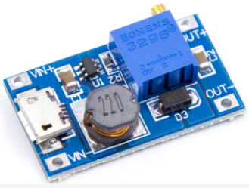
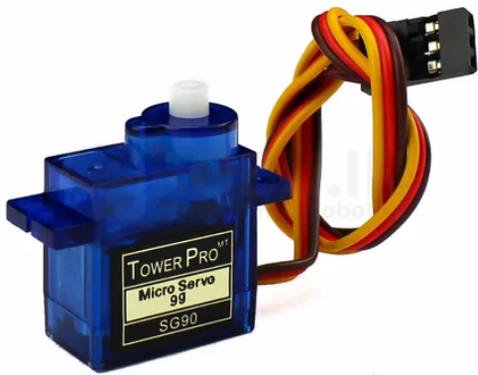
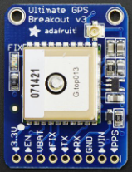
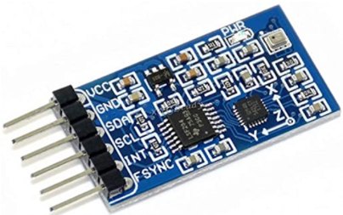
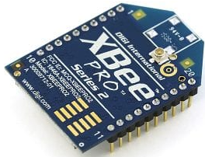
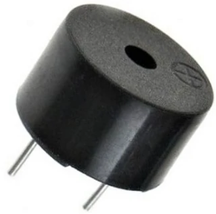
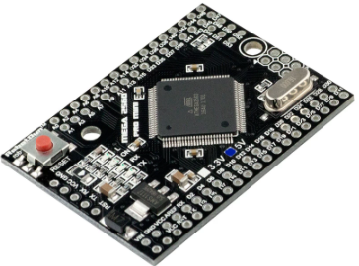
Container Electrical Block Diagram (1 of 2)
VOLTAGE DIAGRAM
Plugs into Payload Component
5V
Servo SG90
12V
AMS1117
Step UP XY-016
5V
7.4V
7.4V
Servo SG90
Switch
5V
Adafruit Ultimate
GPS
7.4V
2 x Samsung 18650 30Q
Reference
Common Ground ( - )
Positive Sign ( + )
5V
10 DOF
IMU SENSOR
5V
Arduino Mega 2560 Mini
XBee RX
5V
3.3V
5V
Buzzer
Plugs into Payload Component
Presenter: Name goes here

Slide 89
Container Electrical Block Diagram (2 of 2)
INTERFACE DIAGRAM
Servo SG90
Arduino Mega 2560 Mini
Plugs into Payload Component
Servo SG90
Adafruit Ultimate
GPS
Buzzer
Reference
Control Sign (~)
10 DOF
IMU SENSOR
Arduino Mega 2560 Mini is our microprocessor and control the state, the data and behaviour to all our components in the container and the camera in the Payload.
XBee RX
Presenter: Name goes here

Slide 90
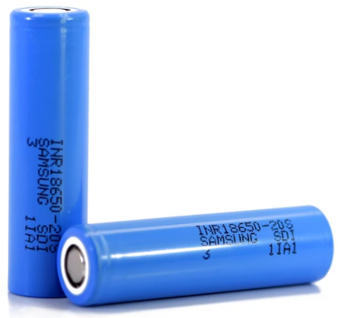
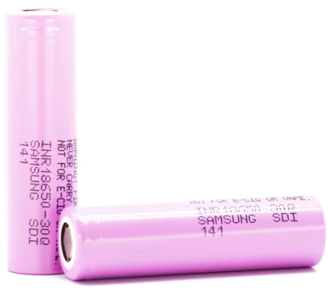

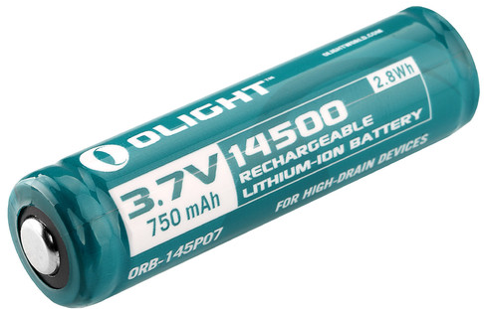
Container Power Trade & Selection (1 of 2)
NO | NAME / MODEL | TYPE | Nominal Voltage (V) | Capacity (mAh) | Weight (g) | Max Continuous Discharging Rate (A) | Price ($) | Source
1 | Olight 14500 | Lithium Ion | 3.7 | 3000 | 46.6 | 30 | 5.99 | Datasheet
2 | Samsung 20S 18650 Battery | Lithium Ion | 3.6 | 2000 | 46 | 30 | 5.99 | Datasheet
3 | Samsung 30Q 18650 Battery | Lithium Ion | 3.6 | 3000 | 48 | 30 | 7.99 | Datasheet
4 | 9V | Alkaline | 9 | 310 | 45 | 0.7 | 3.5 | Datasheet
1
2
3
4
Presenter: Name goes here

Slide 91
Container Power Trade & Selection (2 of 2)
Power Source Selection
Selected Battery: Samsung 30Q 18650 Battery
Reasons
Available in our Country
Rechargeable
High discharge rate
It has capability to deliver enough current and power for the container
Relatively Light
We will use 2 x Samsung 30Q 18650 Battery will be used in SERIE configuration, where we will obtain 7.2V of Nominal Voltage and 3000mAh of Nominal Current.
Both Samsung 30Q 18650 will mounted on container using battery socket

Slide 92
Container Power Budget (1 of 2)
NO | COMPONENT | Voltage (V) | Current (mA) | Duty Cycles (Hr) | Power Consumption (Wh) | Source
1 | Servo SG90 N°1 | 5 | 650 | 0.016 | 0.052 | Datasheet
2 | Servo SG90 N°2 | 5 | 650 | 0.016 | 0.052 | Datasheet
3 | Arduino Mega 2560 Mini | 5 | 0.51 | 2 | 0.0051 | Datasheet
4 | Modulo Xbee | 3.3 | 23 | 2 | 0.1518 | Datasheet
5 | Adafruit Ultimate GPS | 5 | 20 | 2 | 0.2 | Datasheet
6 | 10 DOF IMU Sensor | 5 | 42 | 2 | 0.42 | Datasheet
7 | Step Up XY-016 | 7.4 | 26 | 2 | 0.385 | Estimate
8 | AMS1117 | 5 | 0.2 | 2 | 0.12 | Datasheet
9 | Buzzer | 5 | 500 | 0.016 | 0.04 | Datasheet
Presenter: Name goes here

Slide 93
Container Power Budget (2 of 2)
Total Power Consumed in Container (for Two Hours)
1.4259 Wh
Available Total Current Capacity (for Two Hours) | Available Total Power Capacity (for Two Hours)
3000mAh | 10.8Wh
Margin of Power Consumption (for Two Hours)
10.8 Wh - 1.4259 Wh = 9,3741 Wh (Margin 86.8%)
Conclusion: Our Battery is sufficient to power all component through the flight
We will add a final slide adding the consumption calculations of the container and the Payload, since they use the same battery as a source and the final calculation will be better represented there.

Slide 94
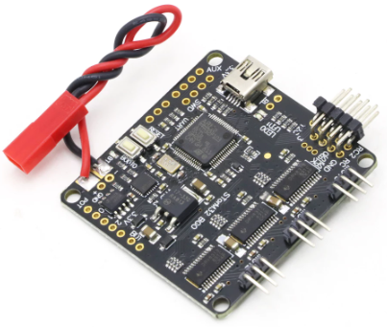


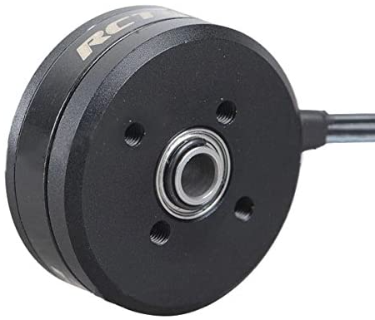
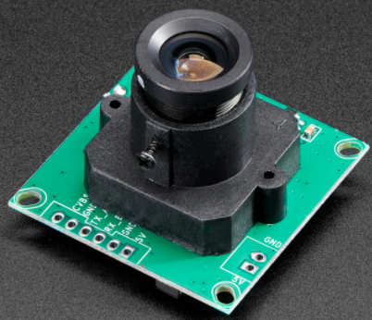
Payload Electrical Block Diagram (1 of 2)
VOLTAGE DIAGRAM
Reference
Common Ground ( - )
Positive Sign ( + )
10 meter cable
Both component are in the container
STorm 32
Controller
12V
9V
Motor 2208 80T
Step UP XY-016
9V
Motor 2208 80T
10 meter cable
AMS 1117
9V
Motor 2804 100T
5V
Mini Spy Camera
Presenter: Name goes here

Slide 95
Payload Electrical Block Diagram (1 of 2)
INTERFACE DIAGRAM
Reference
Control Sign (~)
This component are in the container
10 meter cable
Arduino Mega 2560 Mini
Mini Spy Camera
The Arduino Mega 2560 Mini tells the camera
when to start recording and when to end
Presenter: Name goes here

Slide 96


Payload Power Trade & Selection (1 of 2)
NO | NAME / MODEL | TYPE | Nominal Voltage (V) | Capacity (mAh) | Weight (g) | Max Continuous Discharging Rate (A) | Price ($) | Source
1 | LIR3048 | Lithium Ion | 3.6 | 230 | 12 | 0.001 | 3.45 | Datasheet
2 | CR123A / 16340 | Lithium Ion | 3.7 | 1800 | 24 |  | 5.87 | Estimate
3 | Samsung 30Q 18650 Battery | Lithium Ion | 3.6 | 3000 | 48 | 30 | 7.99 | Datasheet
4 | 9V | Alkaline | 9 | 310 | 45 | 0.7 | 3.5 | Datasheet
1
2
3
4
Presenter: Name goes here

Slide 97
Payload Power Trade & Selection (2 of 2)
Power Source Selection
Selected Battery: Samsung 30Q 18650 Battery
Reasons
Available in our Country
Rechargeable
High discharge rate
It has capability to deliver enough current and power for the payload
Relatively Light
We will use 2 x Samsung 30Q 18650 Battery will be used in SERIE configuration, where we will obtain 7.2V of Nominal Voltage and 3000mAh of Nominal Current.
Both Samsung 30Q 18650 will mounted on container using battery socket and connect with payload components with cable

Slide 98
Payload Power Budget (1 of 2)
NO | COMPONENT | Voltage (V) | Current (mA) | Duty Cycles (Hr) | Power Consumption (Wh) | Source
1 | STorm32 Controller | 12 | 15 | 2 | 0.36 | Estimate
2 | Motor 2208 80T | 7.4 | 30 | 2 | 0.44 | Datasheet
3 | Motor 2208 80T | 7.4 | 30 | 2 | 0.44 | Datasheet
4 | Motor 2804 100T | 7.4 | 7.4 | 2 | 0.44 | Datasheet
5 | Adafruit Mini Spy Camera | 5 | 110 | 2 | 1.1 | Datasheet
Presenter: Name goes here

Slide 99
Payload Power Budget (2 of 2)
Total Power Consumed in Payload (for Two Hours)
2.78 Wh
Available Total Current Capacity (for Two Hours) | Available Total Power Capacity (for Two Hours)
3000mAh | 10.8Wh
Margin of Power Consumption (for Two Hours)
10.8 Wh - 2.78 Wh = 8.02 Wh (Margin 74.25%)
Conclusion: Our Battery is sufficient to power all component through the flight
We will add a final slide adding the consumption calculations of the container and the Payload, since they use the same battery as a source and the final calculation will be better represented there.
Presenter: Name goes here

Slide 100
Container and Payload Power Budget
Total Power Consumed in Container (for Two Hours)
1.4259 Wh
Total Power Consumed in Payload (for Two Hours)
2.78 Wh
Available Total Current Capacity (for Two Hours) | Available Total Power Capacity (for Two Hours)
3000mAh | 10.8Wh
Margin of Power Consumption (for Two Hours)
10.8 Wh - 1.426Wh - 2.78 Wh = 6.594 Wh (Margin 61%)
Final Conclusion
Our Battery is sufficient to power all component through the flight and can operate Two Hours without problems.
Presenter: Name goes here

Slide 101
Flight Software (FSW) Design
Presenter Name(s) Go Here

Slide 102
FSW Overview
Overview of the CanSat FSW design
Should discuss
Basic FSW architecture, a flow chart showing how the software flow
Programming languages
Development environments
Brief summary of the FSW tasks
Differences between Container and Payload
Presenter: Name goes here

Slide 103
Container FSW State Diagram
Software state diagrams for Container defining the states and transition conditions of the flight software
Include:
Sampling of sensors (including rates)
Communications (command and telemetry)
Data storage (if applicable)
Mechanism activations
Major decision points in the logic
FSW recovery to correct state after processor reset during flight
What data is used to recover?
Identify reasons for reset, and methods of recovery
Presenter: Name goes here

Slide 104
Payload FSW State Diagram
Software state diagrams for Payload defining the states and transition conditions of the flight software
Include:
Sampling of sensors (including rates)
Communications (command and telemetry)
Data storage (if applicable)
Mechanism activations (if applicable)
Major decision points in the logic
FSW recovery to correct state after processor reset during flight
What data is used to recover?
Identify reasons for reset, and methods of recovery
Presenter: Name goes here

Slide 105
Simulation Mode Software
Describe the implementation of simulation mode where simulated pressure sensor data is transmitted to the container so simulate the mission
Describe simulation mode commands
How is simulated sensor data substituted with real data?
See the competition guide for detailed requirements
Presenter: Name goes here

Slide 106
Software Development Plan
A common CanSat problem is late software development
Present a slide describing the plan for software development and plans to reduce the risk of late software development
Include:
Prototyping and prototyping environments
Software subsystem development sequence
Development team
Test methodology
Presenter: Name goes here

Slide 107
Ground Control System (GCS) Design
Presenter Name(s) Go Here

Slide 108
GCS Overview
Include a simple context diagram showing major components (computers, antenna, adaptors, etc.)
Presenter: Name goes here

Slide 109
GCS Design
Show diagram of ground station
What components and how they connect
Specifications
How long ground station can operate on battery
Overheating mitigation (how do you keep laptop from getting so hot, it stops operating? Remember, it will be hot and the ground station will be in the open sun.)
Auto update mitigation (how do you keep the OS from starting an update during operations? It has happened before with Windows OS)
Presenter: Name goes here

Slide 110
GCS Antenna Trade & Selection
Show selection of antennas or custom design
Show antenna patterns
Show any design for mounting antenna
Remember antenna will be hand-held or table top
Show at least two designs
Indicate selected design and reasons for selection
See slide discussing trade studies at the end of this PowerPoint
Presenter: Name goes here

Slide 111
GCS Software
Telemetry display prototypes
Commercial off the shelf (COTS) software packages used
Real-time plotting software design
Command software and interface
Telemetry data recording and media presentation to judges for inspection
Describe .csv telemetry file creation for judges
Simulation mode description
Describe how the ground system reads the profile and transmits simulation commands
Presenter: Name goes here

Slide 112
MQTT Integration
Messaging Queuing Telemetry Transport (MQTT) is a publishing and subscription based messaging system that will be used for CanSat 2022 remote viewing of telemetry data during the mission
Describe the ground software design to be used to connect to the remote MQTT server and submit telemetry packets
Include Container and Payload telemetry
Include languages and libraries used
Describe how submission of MQTT data can be enabled/disabled
Describe MQTT test plans
Presenter: Name goes here

Slide 113
CanSat Integration and Test
Presenter Name(s) Go Here

Slide 114
CanSat Integration and Test Overview
The goal(s) at PDR are
Get teams thinking about how to put all the pieces together
Get teams thinking about how to test the integrated assembly to make sure it works as a unit
Discuss subsystem level test plans
Discuss integrated level functional test plans
Discuss environmental test plans
Discuss simulation test plans
Presenter: Name goes here

Slide 115
Subsystem Level Testing Plan
Discuss plans for testing each subsystem
Sensors
CDH
EPS
Radio communications
FSW
Mechanical
Descent Control
Presenter: Name goes here

Slide 116
Integrated Level Functional Test Plan
Discuss tests to be performed after Payload and container are built
Descent testing
Communications
Mechanisms
Deployment
Presenter: Name goes here

Slide 117
Environmental Test Plan
Discuss plans for environmental testing
Drop test
Thermal test
Vibration test
Fit Check
VACUUM test
Presenter: Name goes here

Slide 118
Simulation Test Plan
Discuss plans for simulation testing
What parts of the cansat get tested during simulation
How is the simulation implemented
Presenter: Name goes here

Slide 119
Mission Operations & Analysis
Presenter Name(s) Go Here

Slide 120
Overview of Mission Sequence of Events
Preliminary launch-day sequence of events
Should start with arrival at the launch site and proceed through recovery and data analysis
Include:
Flowchart of events
Team member roles and responsibilities
Antenna construction and ground system setup
CanSat assembly and test
Preliminary at PDR
Presenter: Name goes here

Slide 121
Mission Operations Manual Development Plan
Discuss development and content of the Missions Operations Manual for your CanSat
Presenter: Name goes here

Slide 122
CanSat Location and Recovery
Discuss how you will find your CanSats in the field
Discuss container and payload recovery
Color selection of visible components
CanSat return address labeling
On the container and payload
Presenter: Name goes here

Slide 123
Requirements Compliance
The purpose of this section is to summarize and cross reference the compliance to the CanSat Competition Mission Guide requirements.
Presenter Name(s) Go Here

Slide 124
Requirements Compliance Overview
State current design compliance to requirements
Summarize content of the detailed slides that follow
If the design does not comply to the requirements, that is a serious issue – why?
Presenter: Name goes here

Slide 125
Requirements Compliance (multiple slides, as needed)
Provide a table demonstrating compliance to all competition base requirements
Use the following format in as many slides as required
Rqmt Num | Requirement | Comply / No Comply / Partial | X-Ref Slide(s) Demonstrating Compliance | Team Comments or Notes
1 | Total mass of the CanSat (science payload and container) shall be 500 grams +/- 10 grams. | Comply | x, y, z | Everything should be green by CDR.
2 | CanSat shall fit in a cylindrical envelope of 125 mm diameter x 310 mm length. Tolerances are to be included to facilitate container deployment from the rocket fairing. | -- | -- | --
3 | The container shall not have any sharp edges to cause it to get stuck in the rocket payload section which is made of cardboard. | Partial |  | Medium problem: why?
4 | The container shall be a fluorescent color; pink, red or orange. | No Comply |  | Big problem: why?
5 | The rocket airframe shall not be used to restrain any deployable parts of the CanSat.
6 | The rocket airframe shall not be used as part of the CanSat operations.
Use the Green (Comply), Yellow (Partial Compliance), and Red (No Comply) color codes as shown in the examples above for each requirement
Presenter: Name goes here

Slide 126
Management
Presenter Name(s) Go Here

Slide 127
CanSat Budget – Hardware
Provide a table listing the costs of all CanSat flight hardware
Table should include
Cost of each component/hardware
Indication of whether these costs are actual, estimates, or budgeted values
Indication of hardware re-use from previous years
The current market value for re-used components should be included
Note: re-used flight hardware has been known to be more likely to fail
Include market value for any free components and materials
Presenter: Name goes here

Slide 128
CanSat Budget – Other Costs
The goal(s) of this budget are
To provide an understanding of the overall design and development costs
Get the teams thinking about the overall costs including necessary funds for travel
Identify shortfalls in the budget that require attention
In the past some teams have not been able to attend the competition due to a lack of funds
If caught early enough, there are a number of resources for funding that may available to teams
Table(s) (same format as Hardware Budget) showing
Ground control station costs
Other costs
Prototyping
Test facilities and equipment
Rentals
Computers
Travel
Sources of income
THE COMPETITION DOES NOT PROVIDE ANY DEVELOPMENT FUNDING OR DONORS
Presenter: Name goes here

Slide 129
Program Schedule Overview
A one page Gantt summary chart showing task start and stop dates and durations shall be presented
Schedule should include linkages between tasks to provide the team with an idea of what happens in the overall flow when milestones are not met on time
Make sure the schedule is readable in the presentation
Failure to do so will result in a loss of points
Presenter: Name goes here

Slide 130
Detailed Program Schedule
Details of development schedule to include
Competition milestones
Academic milestones and holidays
Major development activities with assignments
Component/hardware deliveries
Major integration and test activities and milestones
Team member vacations
This can be presented in Gantt chart or table format
The goals of this schedule are to
Provide a tool for the team to track progress of CanSat design and development
Provide tool for judges to assess trouble areas and offer ways for the team to best meet the objectives of the competition
Make sure the schedule is readable in the presentation
This may require the schedule to be broken between multiple slides
Failure to do so will result in a loss of points
Presenter: Name goes here

Slide 131
Conclusions
Presentation summary and conclusions
In general include the following:
Major accomplishments
Major unfinished work
Why you are ready to proceed to next stage of development
Presenter: Name goes here

